Slide 1

Revolutionizing Risk Management: The DataConnect Transformation Program
This presentation outlines our strategic initiative to transform enterprise-wide risk aggregation and reporting through automation and cutting-edge technology. We will demonstrate how the DataConnect program will enhance data quality, streamline processes, and provide unprecedented insights for informed decision-making.

Slide 2
Agenda: Navigating Our Transformation Journey
01
02
The Challenge
Introducing DataConnect
Understanding the current state of manual risk aggregation and its limitations.
Overview of our in-house developed platform and its core capabilities.
03
04
Automating Risk Aggregation
Enhanced Reporting with RiskOne
Deep dive into the transition from manual to automated processes.
Strategic integration and future of risk reporting.
05
06
Key Benefits & Strategic Impact
Roadmap & Next Steps
Summarizing the value proposition and long-term implications.
Outlining our phased approach and immediate actions.

Slide 3

The Current State: Manual Risk Aggregation Challenges
Existing Manual Process:
Consequences:
Disparate data sources across various departments.
Delayed risk reporting and decision-making cycles.
Heavy reliance on manual data collection and consolidation.
Increased operational costs due to labor-intensive processes.
Time-consuming, error-prone spreadsheet-based aggregation.
Higher potential for human error and data discrepancies.
Lack of real-time visibility into enterprise risk posture.
Difficulty in identifying emerging risks proactively.
Limited capacity for in-depth risk analysis and scenario planning.
Inconsistent risk assessments across business units.
Challenges in ensuring data consistency and completeness.
Reduced confidence in the accuracy of risk data presented to stakeholders.

Slide 4

Introducing DataConnect: Our Core Innovation
DataConnect is our proprietary, in-house built tool designed to be the central nervous system for enterprise data. It serves as a robust engine for data ingestion, transformation, and aggregation, specifically engineered to address the complexities of risk data across diverse systems.
Unified Data Hub: Centralizes data from various sources, breaking down existing silos.
Automated Data Pipelines: Replaces manual data transfer with seamless, automated workflows.
Configurable Logic: Allows for custom aggregation rules and data normalization to fit specific risk models.
Scalable Architecture: Built to handle increasing data volumes and evolving business requirements without performance degradation.
User-Friendly Interface: Designed for intuitive use by risk analysts and IT personnel alike.

Slide 5

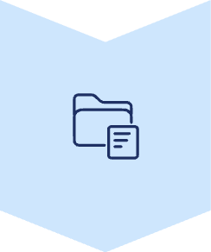
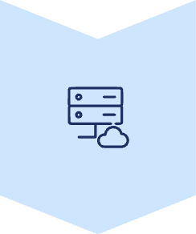
Automating Risk Aggregation: The DataConnect Workflow
1. Data Ingestion
DataConnect pulls raw risk data from multiple internal and external systems (e.g., operational, financial, compliance).
2. Data Validation & Cleansing
Automated checks ensure data accuracy, consistency, and completeness. Irregularities are flagged for review.
3. Data Transformation
Raw data is standardized, harmonized, and enriched according to predefined risk taxonomies and aggregation rules.
4. Aggregation Logic
DataConnect applies sophisticated algorithms to combine and summarize risk metrics at various organizational levels.
5. Output to RiskOne
Aggregated, high-quality risk data is seamlessly fed into the RiskOne platform for comprehensive reporting.
This automated process drastically reduces manual effort, improves turnaround times, and ensures a higher degree of accuracy in our risk aggregation.

Slide 6
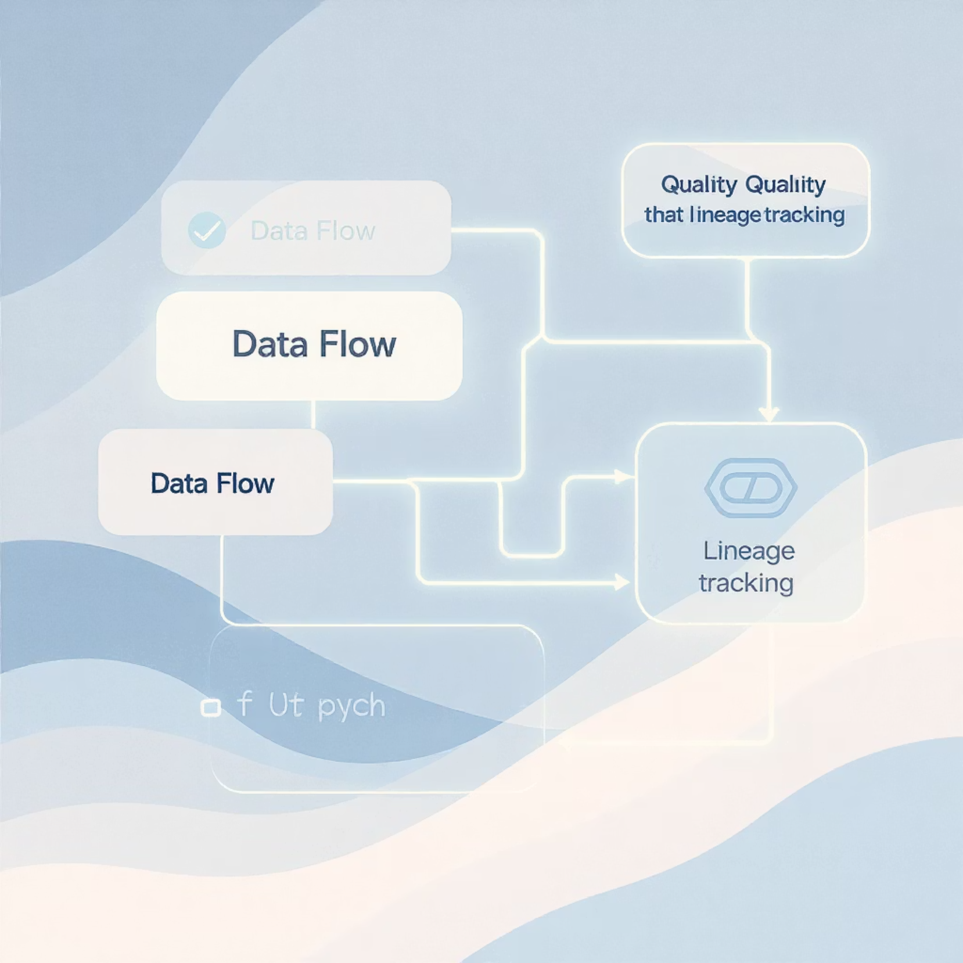
Foundational Advantages: Data Quality & Lineage
Implicit Benefits of DataConnect:
The design of DataConnect inherently addresses two critical aspects often overlooked in traditional data handling:
Enhanced Data Quality: From the moment data is ingested, DataConnect applies rigorous validation rules. This proactive approach minimizes errors at the source, ensuring that only clean, accurate data feeds into our risk models and reports.
Automated Data Lineage: Every piece of data processed through DataConnect retains a clear audit trail. This means we can trace the origin, transformations, and usage of any data point, providing unparalleled transparency and accountability for regulatory compliance and internal scrutiny.
"Clean data is not just about accuracy; it's about building trust and enabling reliable insights."

Slide 7
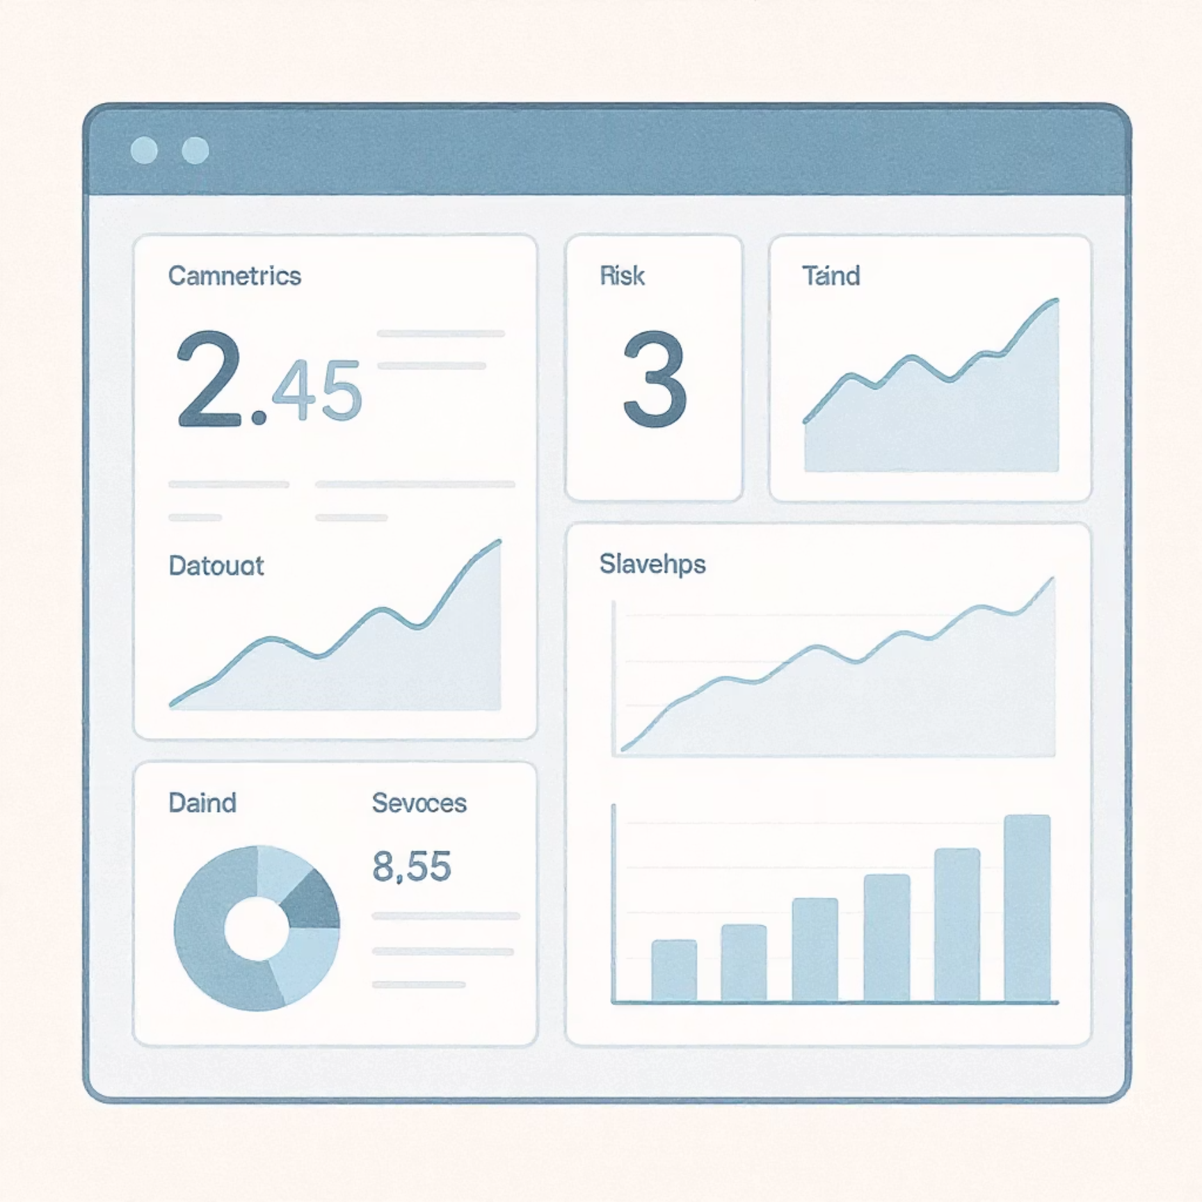
Next Frontier: Enhanced Reporting with RiskOne Platform
The aggregated and high-quality data from DataConnect will now power our enterprise risk reporting through the new RiskOne platform. This year, our focus is on building out four critical reports to deliver immediate value.
Key Reports for 2024 on RiskOne:
Enterprise Risk Overview Dashboard: A high-level, real-time view of top enterprise risks, heatmaps, and key risk indicators (KRIs).
Operational Risk Profile: Detailed breakdown of operational incidents, loss events, and control effectiveness across business units.
Regulatory Compliance Risk Report: Monitoring of adherence to critical regulatory requirements and identification of potential compliance gaps.
Scenario Analysis & Stress Testing Outcomes: Visualization of potential impacts from defined risk scenarios and stress tests.
Future State: All risk reporting, spanning all risk types and reporting cycles, will be consolidated and delivered through the RiskOne platform, becoming the single source of truth for risk intelligence.

Slide 8





Strategic Impact: Benefits & Outcomes
Accelerated Reporting
Reduce report generation time from weeks to days, enabling faster, more agile decision-making.
Enhanced Accuracy
Minimize manual errors and ensure high-fidelity data, leading to more reliable risk assessments.
Deeper Insights
Leverage comprehensive data to uncover hidden risks and identify new opportunities for risk mitigation.
Improved Compliance
Automated lineage and quality controls strengthen our regulatory posture and audit readiness.
Cost Efficiency
Optimize resource allocation by reducing manual effort and improving operational efficiency.

Slide 9
Transformation Roadmap: Key Milestones
Q1 2024
Q3 2024
DataConnect Core Platform Deployment
Deployment of Operational & Regulatory Risk Reports
Integration with First 2 Key Data Sources
Training for Core Risk Team
Expansion of DataConnect Integrations (Additional Sources)
Phase 1 User Acceptance Testing
1
2
3
4
Q2 2024
Q4 2024
RiskOne Platform Integration
Deployment of Scenario Analysis Report
Development of Enterprise Risk Dashboard
Full Transition to Automated Aggregation
Pilot Program for Automated Risk Aggregation
Post-Implementation Review & Optimization
This phased approach ensures a smooth transition, allowing us to deliver value incrementally while managing complexity effectively.

Slide 10

Next Steps: Partnering for a Risk-Intelligent Future
The DataConnect Transformation Program is not just a technological upgrade; it's a strategic investment in our organization's future resilience and agility. By automating risk aggregation and leveraging the power of RiskOne, we are building a foundation for truly proactive and data-driven risk management.
Immediate Actions:
Secure executive endorsement for phase 2 expansion (post-2024 reports).
Key Takeaways:
Establish cross-functional steering committee for ongoing program oversight.
Schedule deep-dive sessions with business units to optimize report adoption.
DataConnect enables automated, high-quality risk aggregation.
Develop comprehensive training modules for all relevant stakeholders.
RiskOne will be the single source of truth for all risk reporting.
This transformation provides unparalleled data quality, lineage, and actionable insights.

